Slide 1
Single-cell RNA-Seq

Slide 2



Bulk
Single Cell

Slide 3
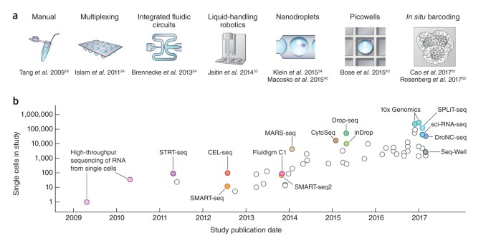
Single Cell RNA-Seq: a recent exploding technology
https://www.nature.com/articles/nprot.2017.149

Slide 4
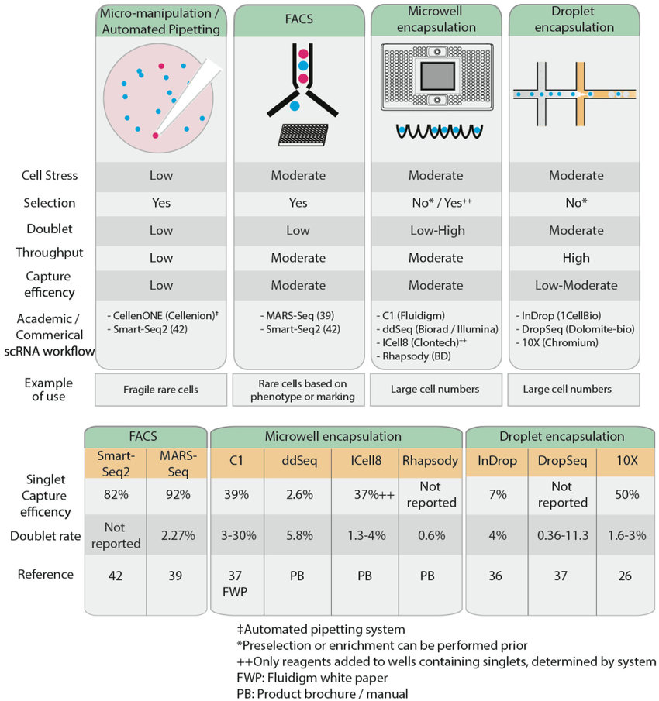
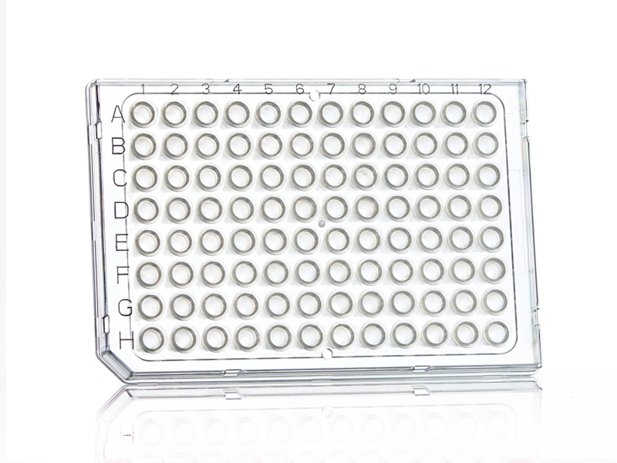
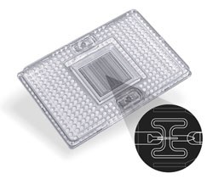
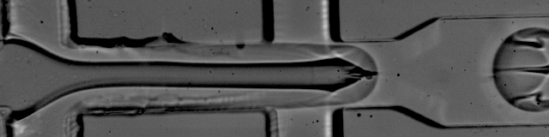
Isolating Single Cells is a big challenge
https://www.frontiersin.org/articles/10.3389/fimmu.2018.01553/full

Slide 5
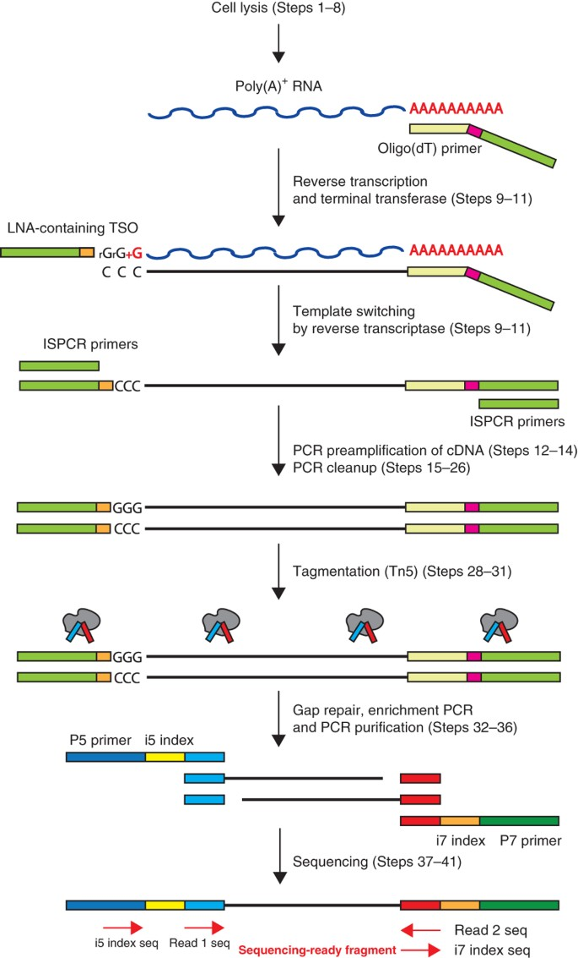
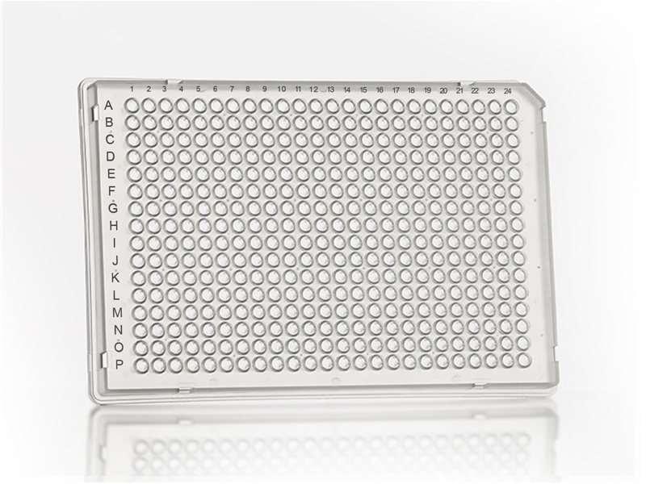
Smart-seq(2)
Smart-seq (current verison V4, the most used/well know is V2) is used to sequence the full-length transcriptome of individual cells
Smaller throughput, usually < 1000 cells
Since fewer cells are sequenced, sequencing depth tends to be higher and thus more genes are captured
https://www.nature.com/articles/nprot.2014.006
Requires laborious lab work
Usually for detailed analysis of specific hard to get cell populations (eg. polen)

Slide 6
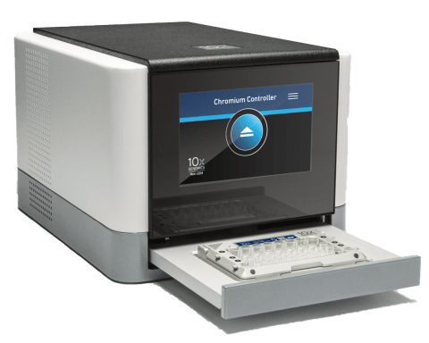
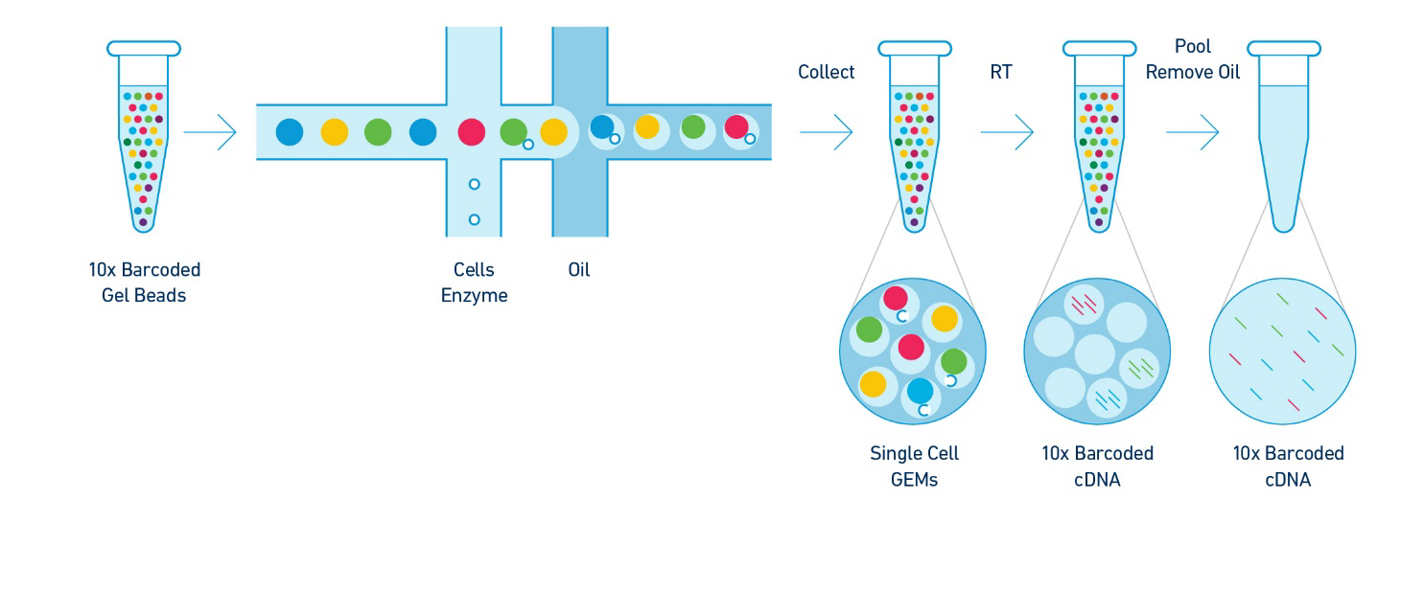
Chromium 10x Genomics
Uses microdroplet encapsulation for individual lysis and amplification
Current version is v3.1; has 3’ and 5’ sequencing variants (not full-length transcripts)
High throughput (5-10k cells/well) – good for organs or even whole small organisms
Tends to get smaller amount of RNA per cell / noisier data
https://www.nature.com/articles/ncomms14049

Slide 7
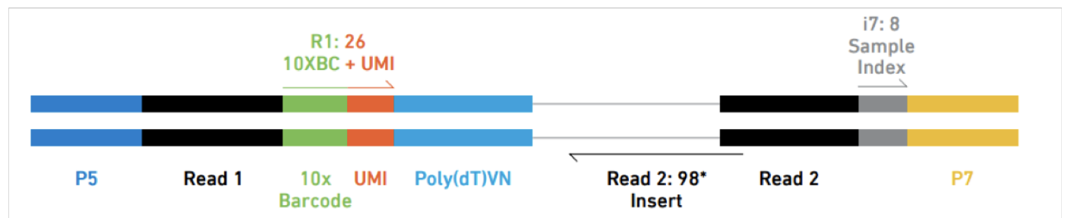
A few extra notes
Some applications add “spike-in” RNA
Used to control quality of samples, since we know the amounts of spike-in beforehand
Spikes often found identified as “ERCCxxx”
The use of UMIs are becoming quite common
To avoid effect of amplification of small amounts of RNA (particularly for 10x genomics)
Each molecule is tagged with a UMI at library preparation
Counts with same UMI should be counted as only 1
Smart-Seq2 does not have it (smart-seq3 now includes)

Slide 8
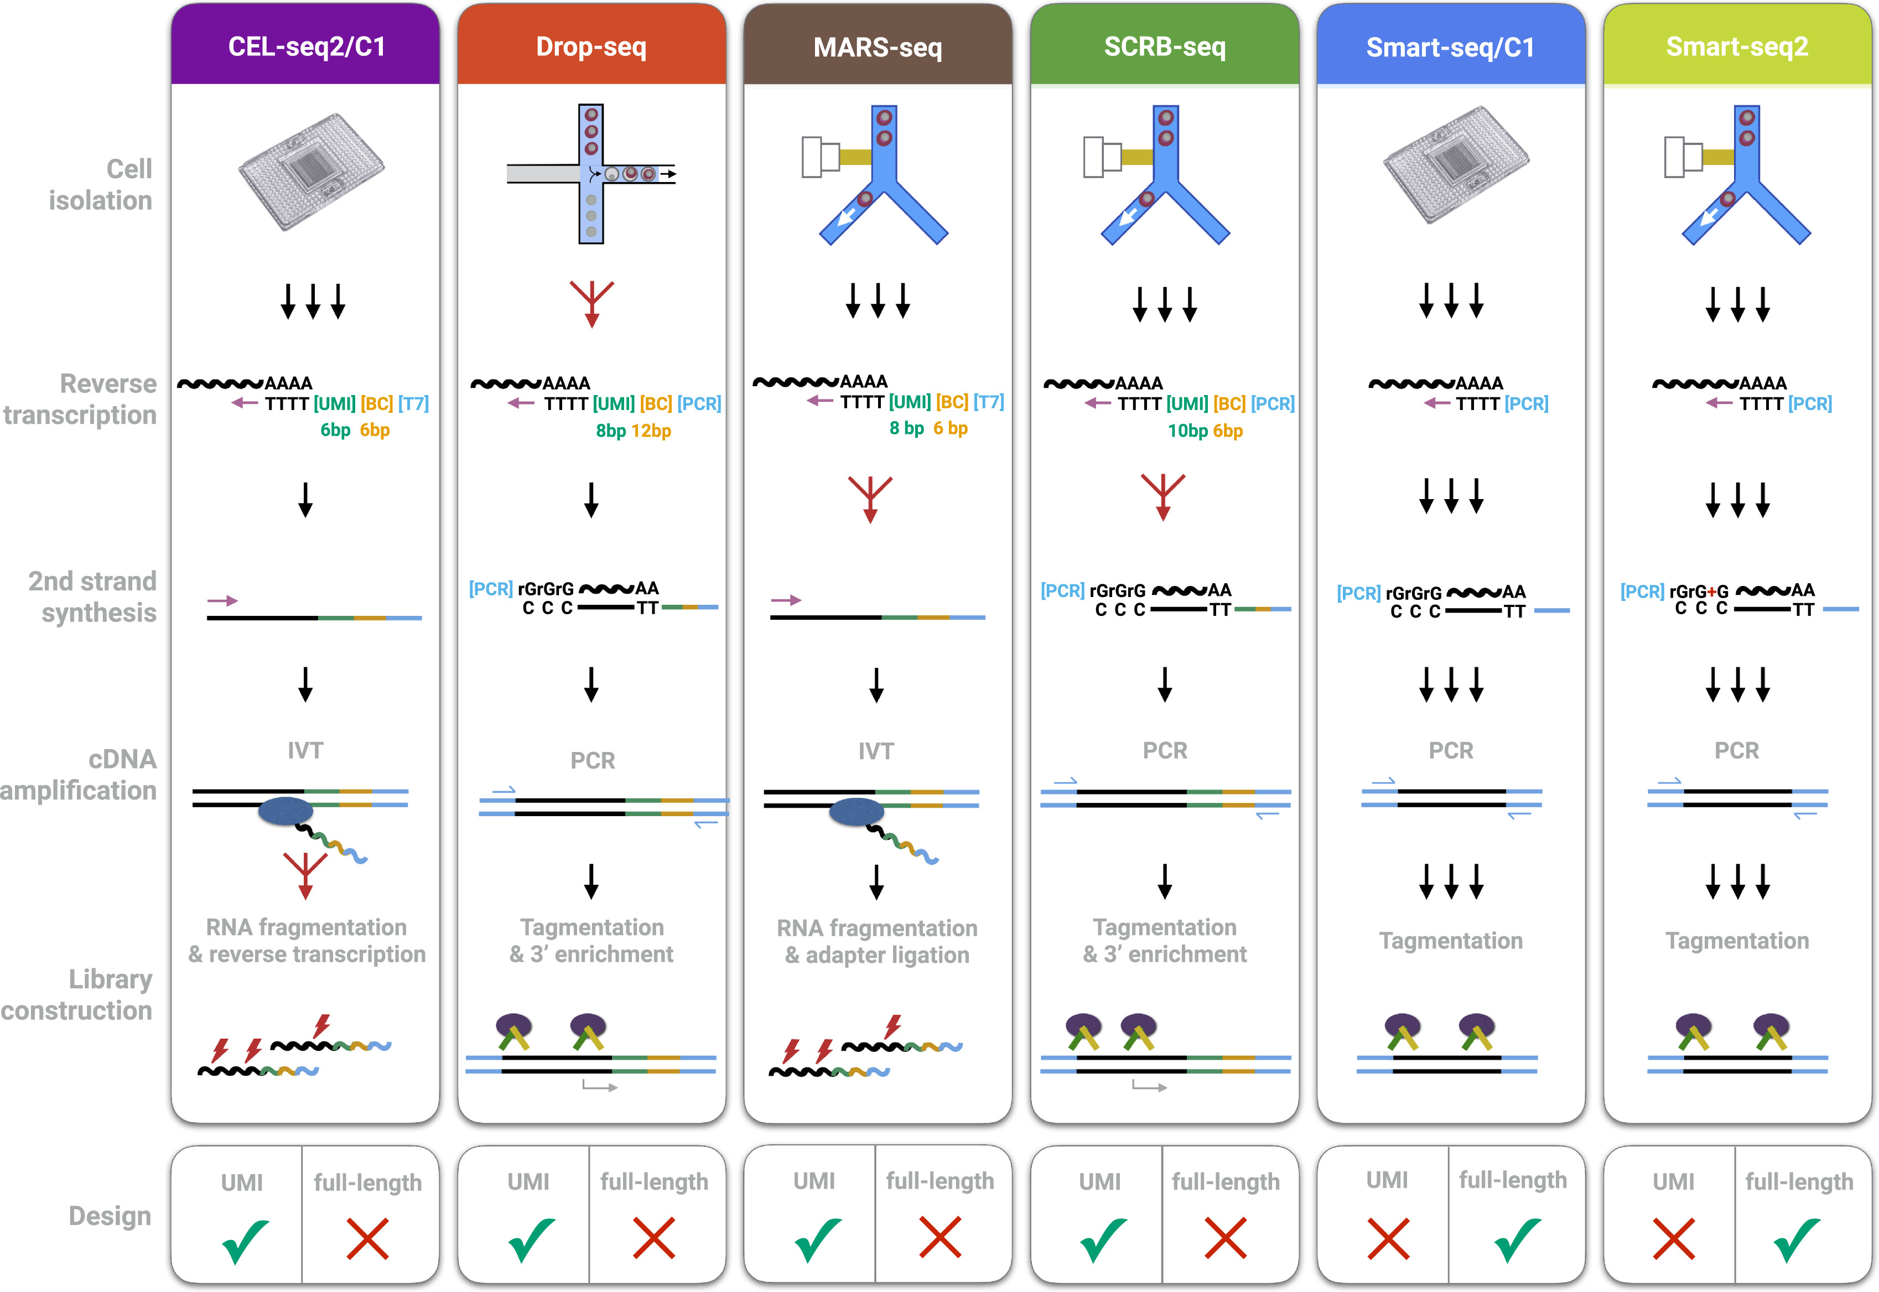
Several factors need to be taken into account
In the end, you use
what you have at
your institute
https://www.sciencedirect.com/science/article/pii/S1097276517300497

